Slide 1
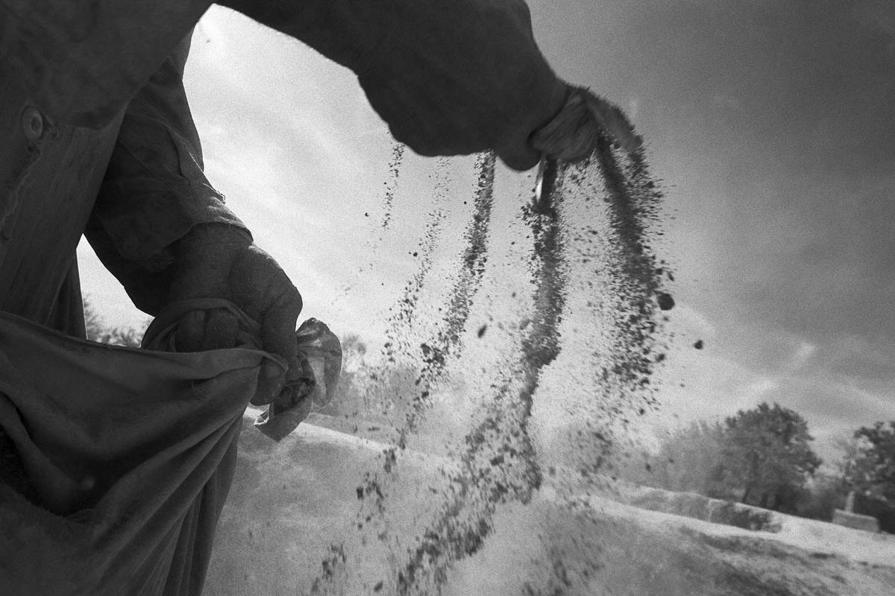

Casting Vision 2018

Slide 2


Slide 3

Discipleship
Service
Mission

Slide 4
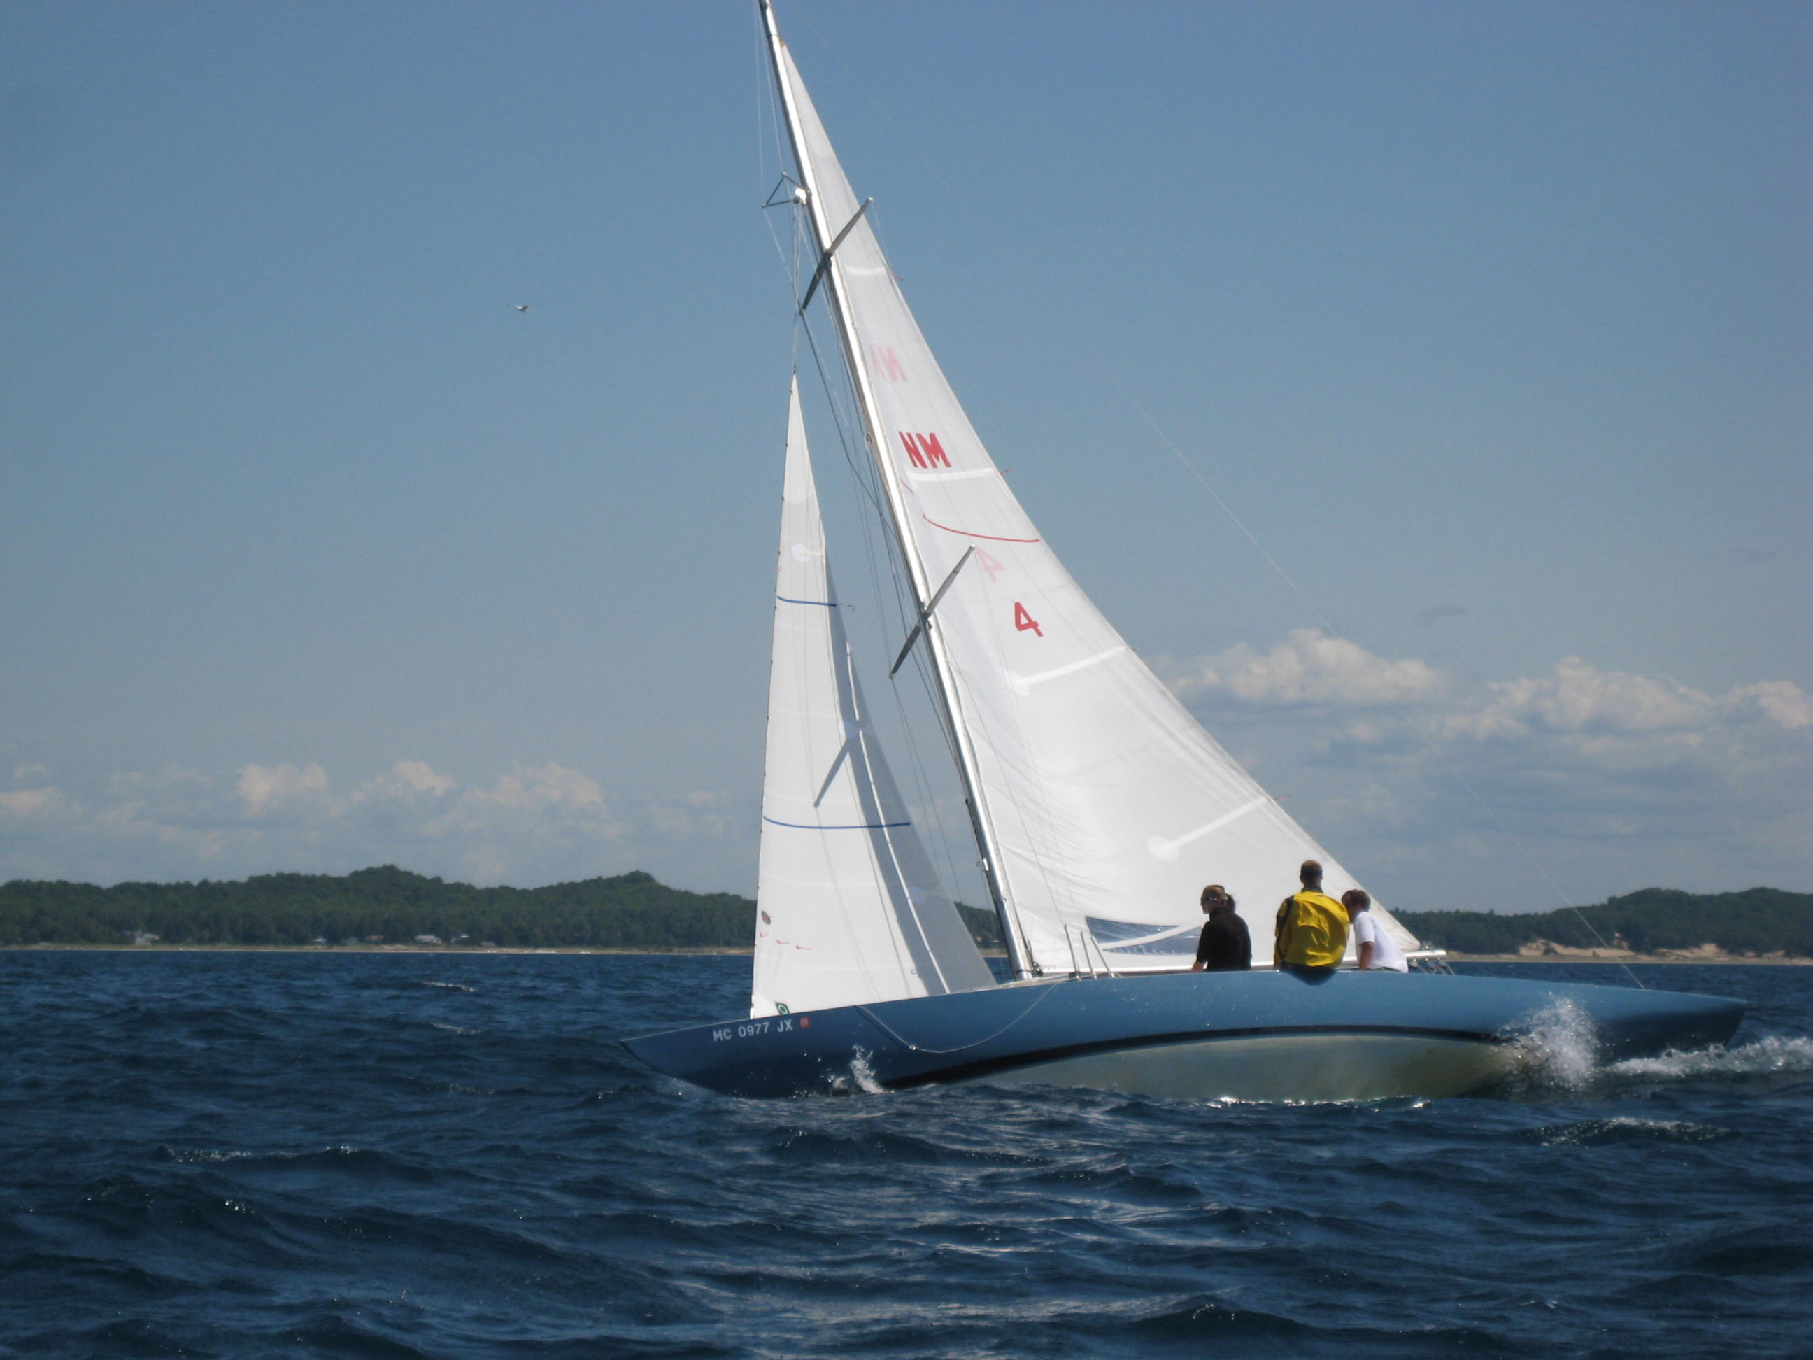
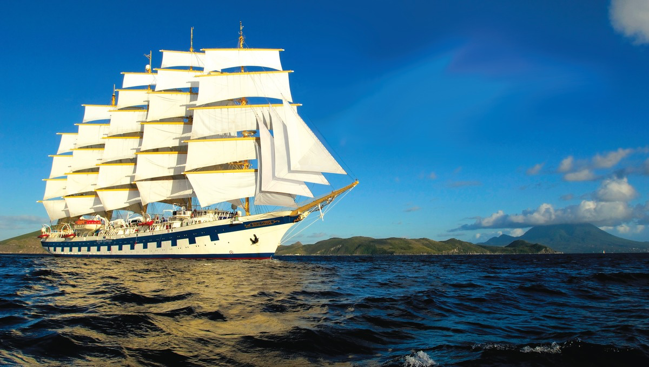
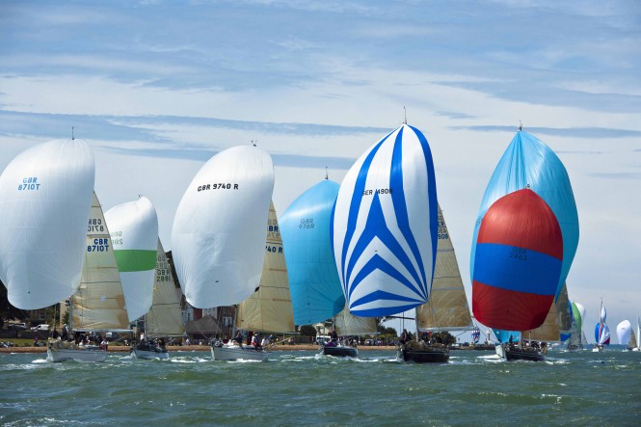

Slide 5
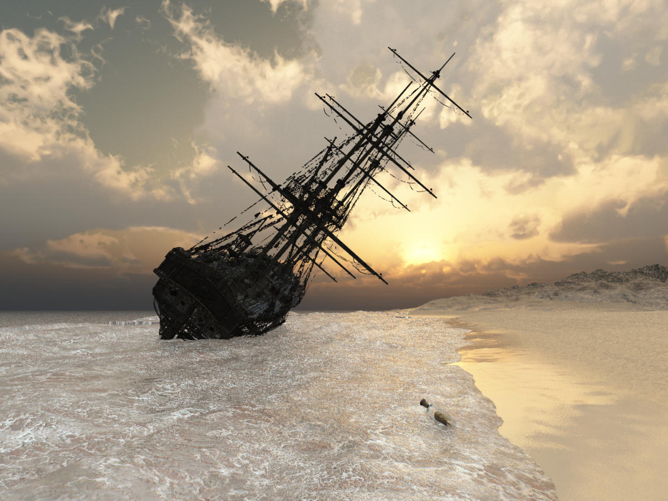

Slide 6
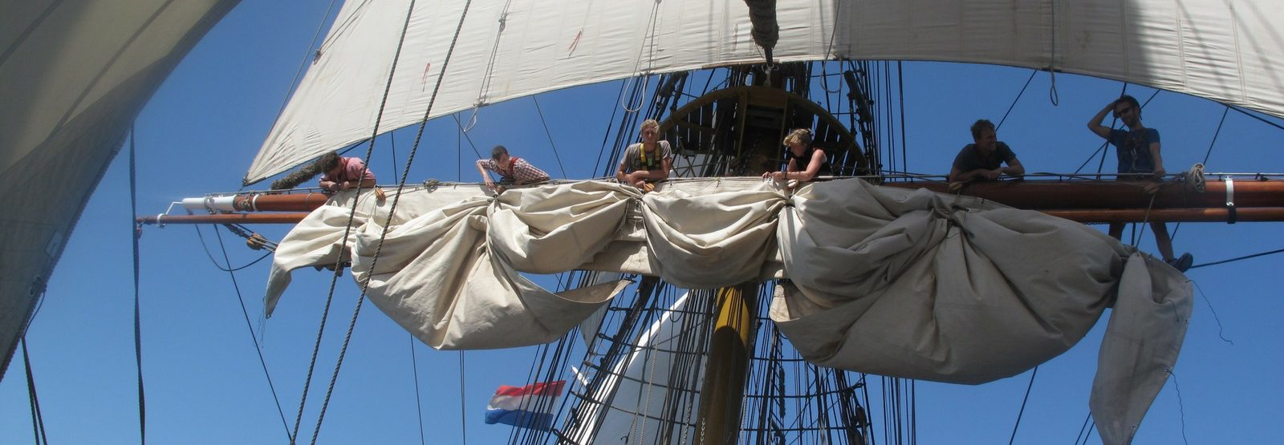

Slide 7
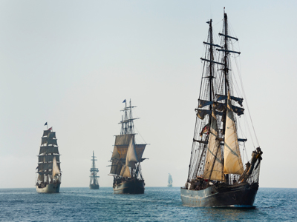
Where are we going?

Slide 8
Then Jesus [the Admiral] came to them and said, “All authority in heaven and on earth has been given to me. [I am the First Sea Lord]
Therefore go and make disciples of all nations, baptizing them in the name of the Father and of the Son and of the Holy Spirit, and teaching them to obey everything I have commanded you. And surely I am with you always, to the very end of the age.”
From the end of the book of Matthew in the Bible

Slide 9
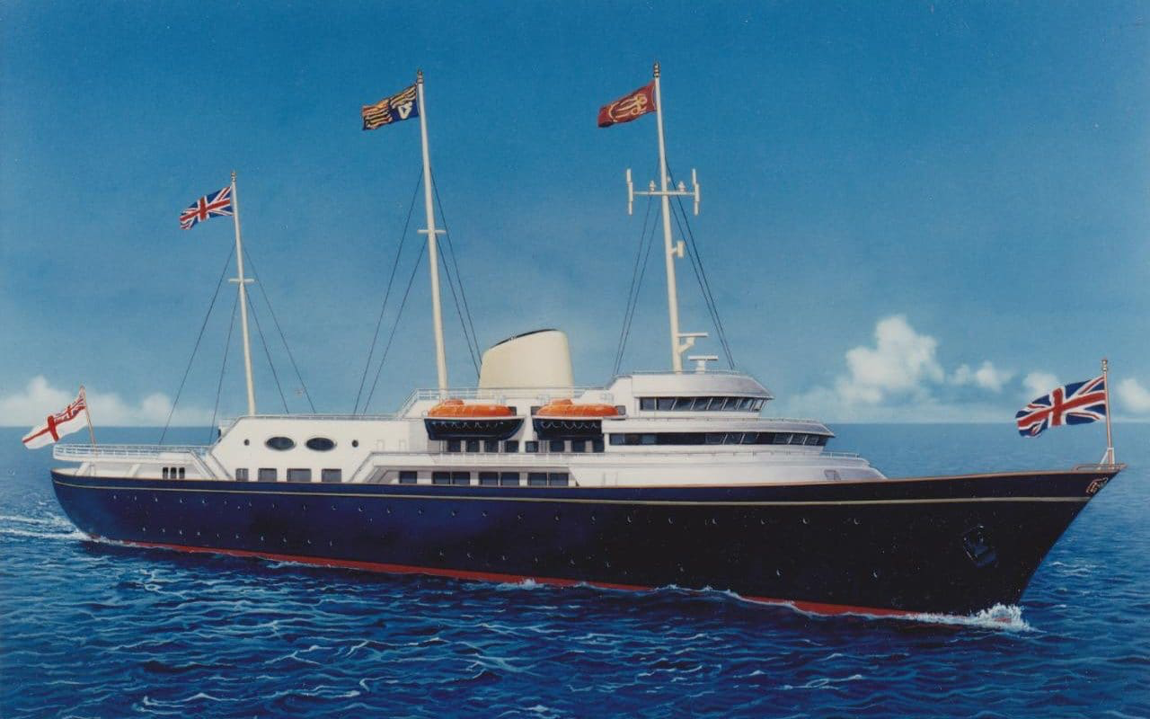

Slide 10
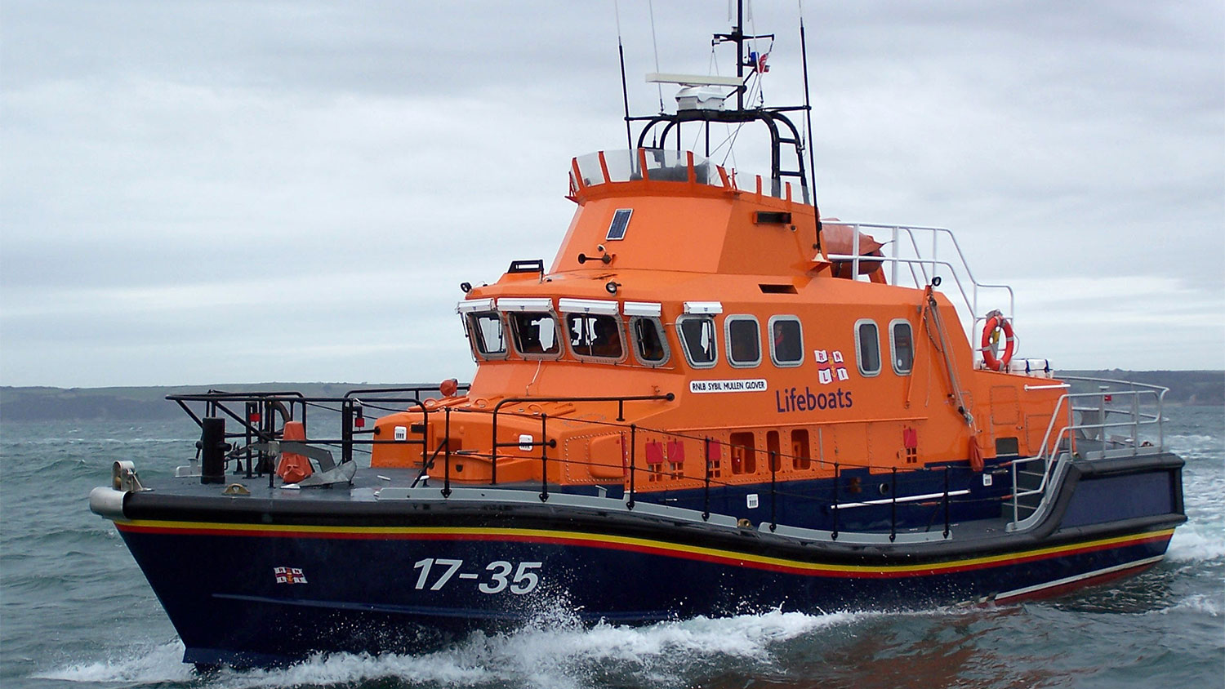

Slide 11
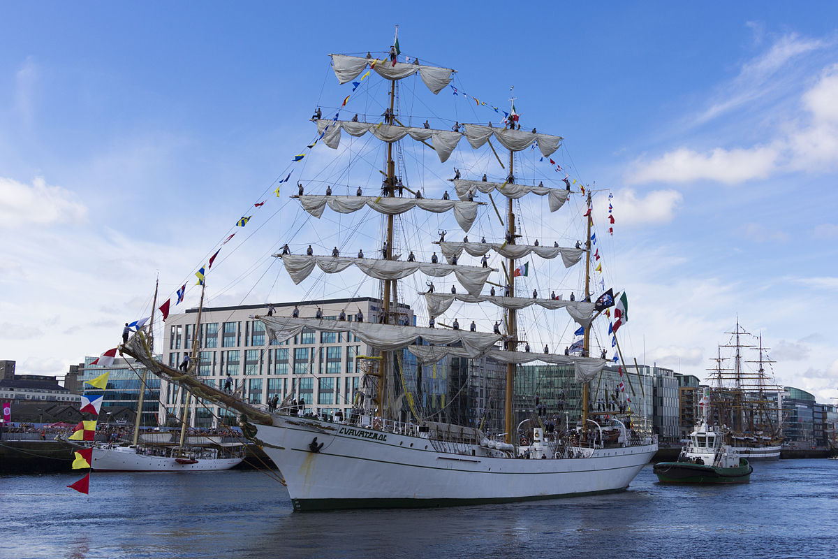

Slide 12
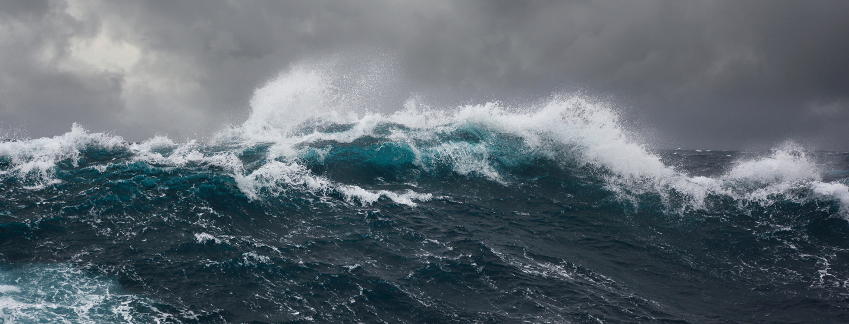
We do not just need to rescue those drowning at sea.
We need to train them up to be able to sail a ship too and then maybe drop them off at a port where they can build their own boats and go out sailing or move on to be useful crew in other boats.

